Slide 1

Project Presentation on
“PETROL PUMP MANAGEMENT SYSTEM”
BACHELOR OF COMPUTER APPLICATION (BCA)
OF
KARNATAK UNIVERSITY, DHARWAD
PROJECT GUIDED BY
Mr. Manjunath Pujar
Submitted By
Snehalata Anklekar
BCA VI semester
DEPARTMENT OF COMPUTER APPLICATIONS 2015-2016
Janata Shikshana Samiti’s
Shri Manjunatheshwara Institute of UG & PG Studies
Vidyagiri, Dharwad-580004

Slide 2

Introduction:
The suggested Project is to develop petrol pump management software for V.R Haldipur and sons petrol pump located at Karwar (Uttar Kannada) for a client named Shailesh Haldipur with global perspective to integrate business processes at Petrol pump, remove duplication of work, increase efficiency, instant actionable reports and timely decision making.
This suggested Project will be developed as primarily as desktop-based application to enhance the function limitation of the system. The management of the petrol pump is done by the owner manually which is a difficult process. The Project deals with the development of the computerized system for maintaining the regular records. The Project consists of various forms and developed with the help of the Personal Home Page (PHP) Programming.

Slide 3
Objective of the Project:
The main objective of the Project on Petrol Pump Management System is to make the automation of the Petrol Pump operations. It involves Purchases and Sales of Petrol(Motor Spirit[M.S.]) and Diesel(High Speed Diesel Oil[H.S.D.O.]) along with Stock maintenance, calculation of gain and loss for every month and year periodically and various other kinds of reports that are generated periodically. This Project helps the Owner of the Petrol Pump Station to record the daily transaction of the station. Owner can view and edit the entered transaction data to correct if there are any mistakes while data is entered. The risk of losing data and the problem of having redundant data can be avoided. Besides by using this system, time taken in recording transactions will be reduced.

Slide 4
Input of the Project
When we purchase petrol or diesel, the quantity will be updated to the previous stock. After sales, stocks to be updated. Information about shift, workers will be updated.

Slide 5
Output of the Project:
On sales of petrol and diesel, we are going to read the meter reading which provides us the complete statistics of capacity or stock remaining with us .We can generate the daily sales, weekly sales and monthly sales.

Slide 6
Process Logic:
INPUT
When we purchase petrol or diesel, the quantity will be updated to the previous stock. After sales, stocks to be updated. Information about shift workers will be updated
PROCESS
Current stock of petrol and diesel is maintained and whenever the stock is added or removed, it is going to be updated
PROCESS
Current stock of petrol and diesel is maintained and whenever the stock is added or removed, it is going to be updated

Slide 7
Working of modules:
Customer module: The Customer is one who makes payment through credit cards, debit cards, cheques or directy through cash. The Customer also purchases the Product at the Petrol Station.
Management (Owner) module: The Owner manages the entire Petrol Pump Station. The Owner checks the Stock Details, Sales Details, Payment Details, Customer Details, Shift Details, Employee Details, Petrol filling machine Details, Product Details and also updates them.
Employee module: The Employee acts as a salesman at the Petrol Station and provides Stock Details, Petrol filling machine Details, Sales Details to the Owner.
Stock Information module: This module maintains the Stock Details. In this module, the input of the Stock received on each and every material is entered.
Payment module: When the Customer’s purchase Petrol or Diesel, the Petroleum Company gives them some time to make Payments. For this period, the Company takes some interest. Payment can be done through credit card, debit card, cheque or directly through cash.

Slide 8
Existing System:
Everyday meter readings are taken and this will be entered in the ledger to calculate the stock.
When the new stock arrives, the same will be updated in stock register.
Manual calculation.
Proposed System:
Every information is updated into a system which will provide us the complete information about sales and stock.
The system is user-friendly.
Computerized system.
Back up support.
Secured data.

Slide 9
Tools, platform and languages used:
1. Hardware requirements:
Processor: Intel Core i3-2350M Processor (3M Cache, 2.30 GHz) or more.
RAM: 1GB or more.
Hard disk: 20 GB.
I/O devices: Monitor, Keyboard, Mouse.
2. Software requirements:
Operating System: Windows XP/7/8.
HTML editor like Dreamweaver.
WAMP Server Version 2.2(for PHP development and execution).
3. Languages Used:
Front End: HTML5 and CSS3.
Middle tier or Web Server: PHP(WAMP Server).
Back End: MySQL.

Slide 10
Limitation of the proposed system:
The transactions are executed in off-line mode. Hence there is no online transaction.
Customer feedback and Complaint facility is not available.
Scope or Future application:
The software can be used in interconnected Petrol pumps to manage the Station.

Slide 11
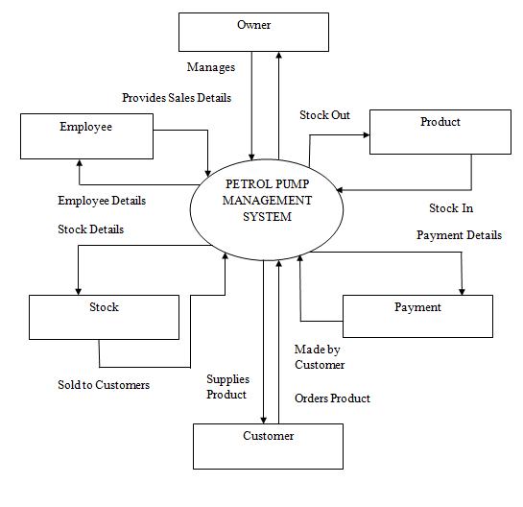
Data Flow Diagram:
Zero Level Data Flow Diagram:

Slide 12
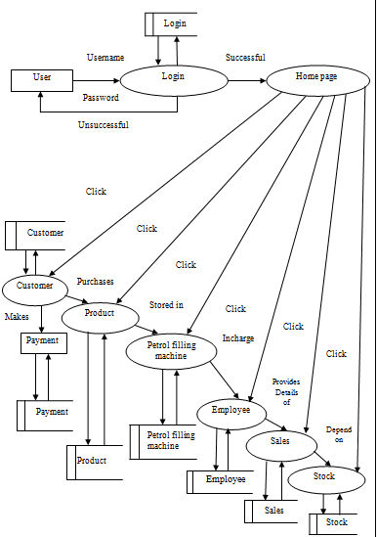
One level Data Flow Diagram:

Slide 13
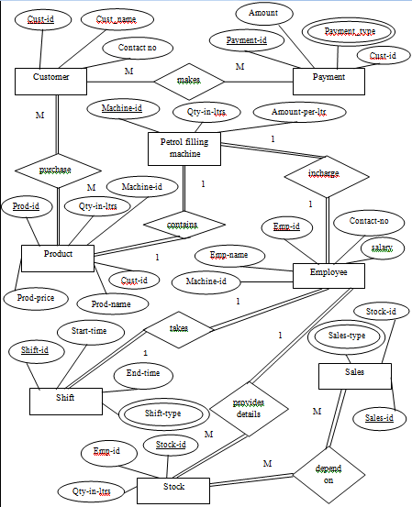
E-R DIAGRAM:

Slide 14
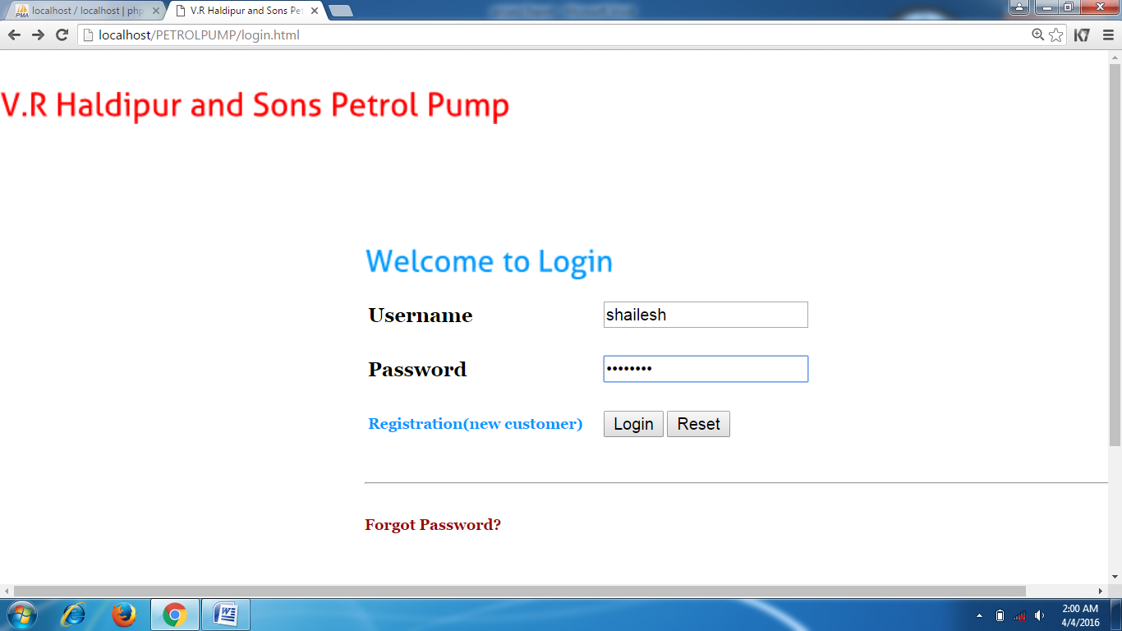
SCREEN SHOTS:
Screen shot for login:

Slide 15
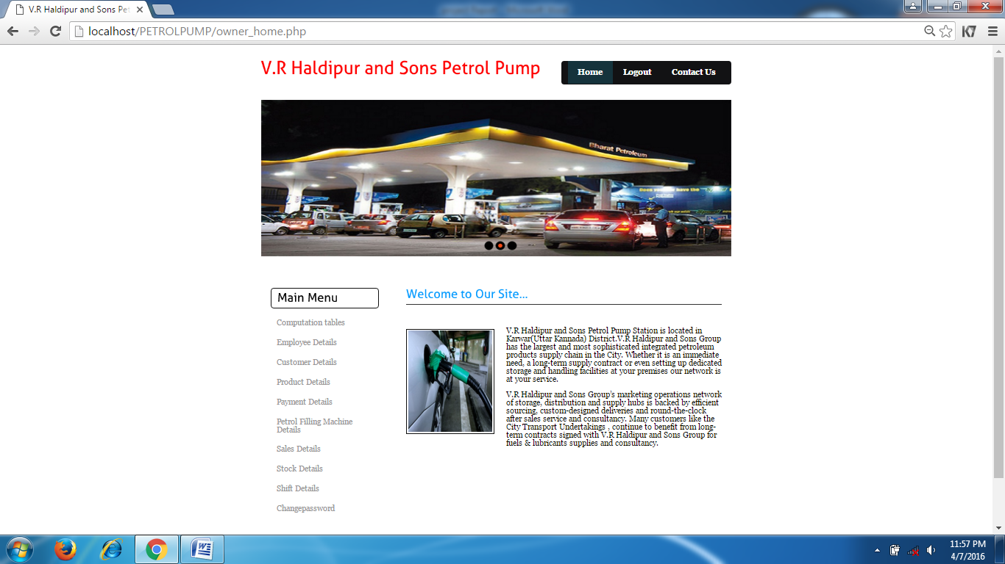

Slide 16
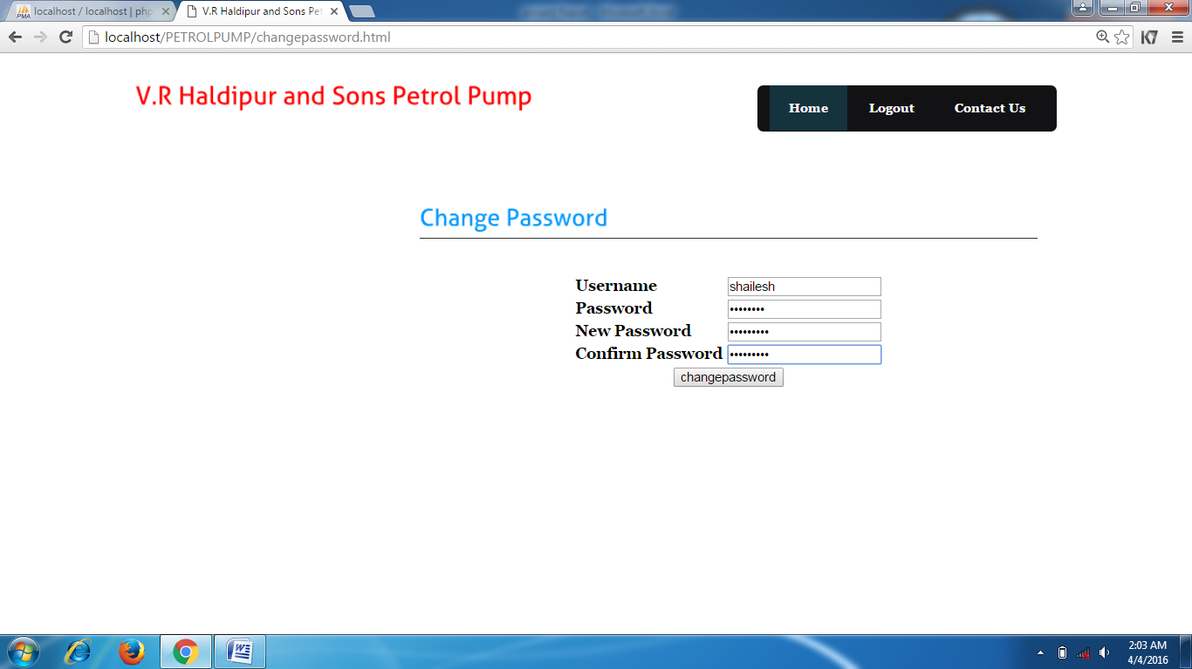
Screen shot for change password:

Slide 17
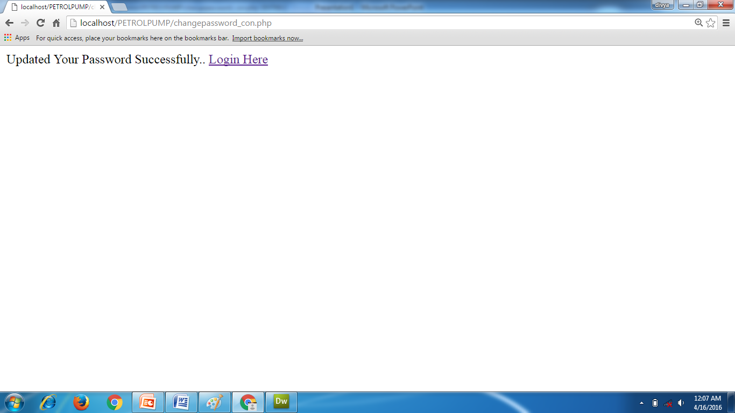

Slide 18
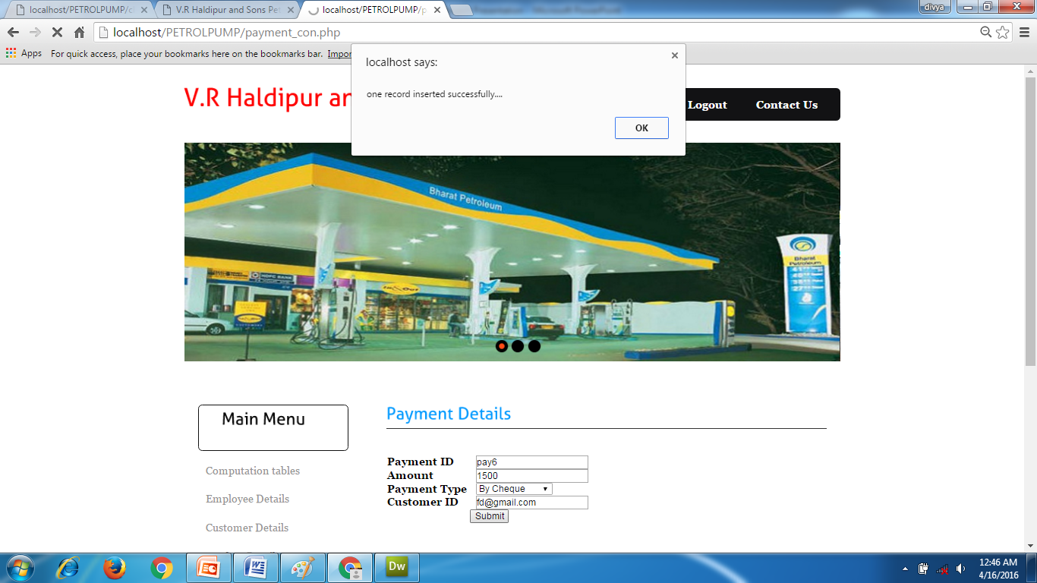
Screen shot for insert payment details:

Slide 19
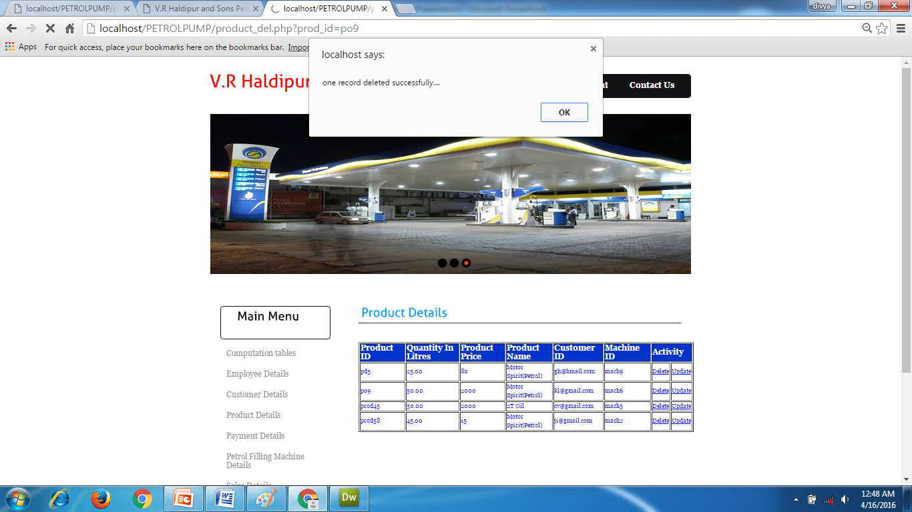
Screen shot for delete product details:

Slide 20
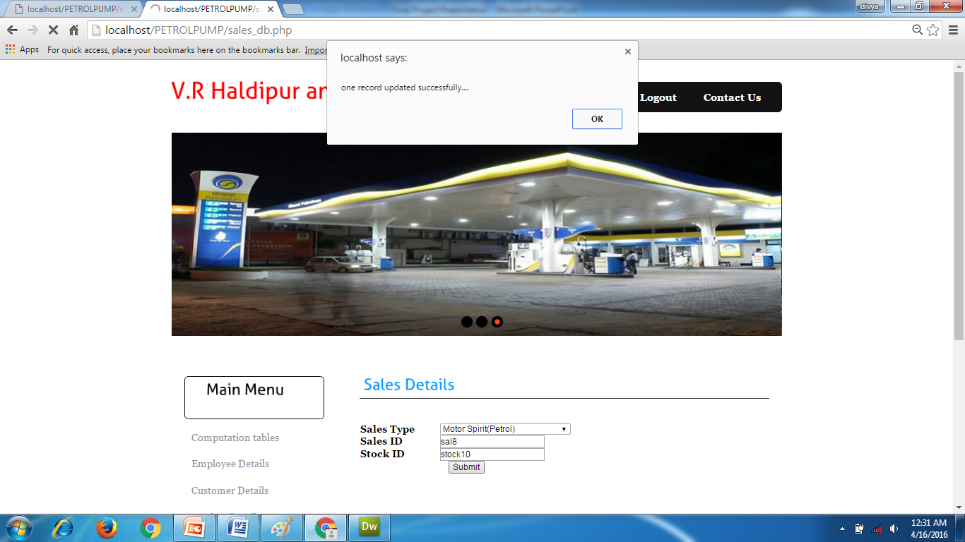
Screen shot for update sales details:

